Slide 1

Machine Learning Interpretability
By Team 7
Maneendar Sorupaka
Pratiksha Sawant
Rajsharavan Senthilvelan
Reema Mehta

Slide 2
What is Machine Learning?
Machine Learning is a set of methods that allow computers to learn from data to make and improve predictions (for example cancer, weekly sales, credit default).
Machine learning is a paradigm shift from “normal programming” where all instructions must be explicitly given to the computer to “indirect programming” that takes place through providing data.

Slide 3
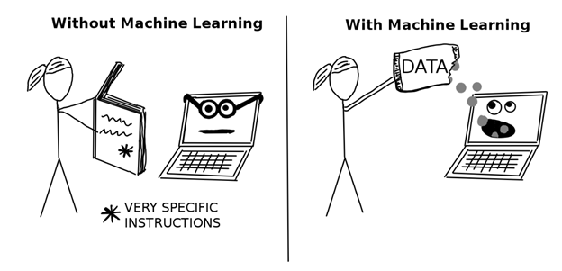

Slide 4
Machine Learning Algorithms
Machine learning algorithms create potentially more accurate models than linear models, but any increase in accuracy over more traditional, better-understood, and more easily explainable techniques is not practical for those who must explain their models to regulators or customers.
For many decades, the models created by machine learning algorithms were generally taken to be black-boxes.

Slide 5
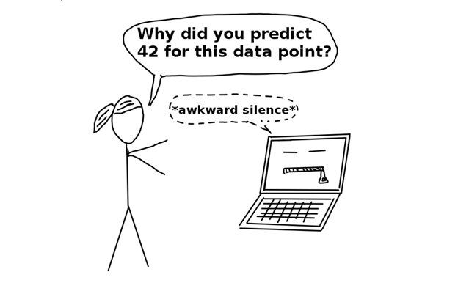
Machine Learning - Black Box Model
A Black Box Model is a system that does not reveal its internal mechanisms.
In machine learning, “black box” describes models that cannot be understood by looking at their parameters (e.g. a neural network). You need millions of numbers to describe a deep neural network, and there is no way to understand the model in its entirety.

Slide 6
Machine Learning Interpretability
Interpretable Machine Learning refers to methods and models that make the behavior and predictions of machine learning systems understandable to humans.
It is a debugging tool for detecting bias in machine learning models
For example an interpreted model can tell you why it has decided that a certain person should not get a loan, and it becomes easier for a human to judge whether the decision is based on a learned demographic (e.g. racial) bias
When the model has a significant impact. For example when someone has to establish a travel business by predicting the most interested holiday destinations

Slide 7
Scope of Interpretability
Global interpretability: Global interpretations help us understand the entire conditional distribution modeled by the trained response function, but global interpretations can be approximate or based on average values.
Local interpretability: Local interpretations promote understanding of small regions of the conditional distribution, such as clusters of input records and their corresponding predictions, or deciles of predictions and their corresponding input rows. Because small sections of the conditional distribution are more likely to be linear, monotonic, or otherwise well-behaved, local explanations can be more accurate than global explanations.

Slide 8
MLI Techniques
The techniques presented here go beyond the standard practices to engender greater understanding and trust.
These techniques enhance understanding by providing specific insights into the mechanisms of the algorithms and the functions they create, or by providing detailed information about the answers they provide.
These techniques are “model-agnostic,” meaning they can be applied to different types of machine learning algorithms

Slide 9
Techniques for MLI
Partial Dependence Plots (PDP) and Individual Conditional Expectation(ICE)
Leave-One-Covariate-Out (LOCO)
Decision Tree Surrogate Model
Sensitivity analysis
Monotonic models with XGBoost
LIME (Local interpretable model-agnostic explanations)

Slide 10
Partial Dependence Plots (PDP)
Partial dependence plots can be used to verify monotonicity of response functions under monotonicity constraints, and they can be used to see the nonlinearity, non-monotonicity, and two-way interactions in very complex models.
They can also enhance trust when displayed relationships conform to domain knowledge expectations, when the plots remain stable or change in expected ways over time, or when displayed relationships remain stable under minor perturbations of the input data.
Notes:
Partial dependence plots show us the way machine-learned response functions change based on the values of one or two independent variables of interest, while averaging out the effects of all other independent variables.
Partial dependence plots with two independent variables are particularly useful for visualizing complex types of variable interactions between the independent variables of interest.

Slide 11
Individual Conditional Expectation (ICE)
ICE plots, newer and less well-known adaptation of partial dependence plots.
They can be used to create more localized explanations using the same ideas as partial dependence plots.
ICE plots are particularly useful when there are strong relationships between many input variables.

Slide 12
Decision Tree Surrogate Model
It’s an interpretable model which is trained to approximate the predictions of a black box model (metaphor used for models in which it is difficult to make sense of the purpose of various components in a model)
Created to represent the decision making process of the complex model
Trained on the inputs and model predictions rather than inputs and targets
Steps:
Select a dataset
For the selected dataset get the predictions of the model
Select an interpretable model type (decision tree)
Train this interpretable model on the dataset and it’s predictions
Measure how well the model replicates
Interpret surrogate model
Notes:
Surrogate models are used in engineering as well when an outcome is expensive, time-consuming or difficult to measure a fast surrogate model of the outcome can be used.
But the difference here is that the underlying model is a machine learning model not a simulation and the models should be interpretable
Black Box Model : It’s a metaphor used in machine learning for models in which it is difficult to make sense of the purpose of the various components in a model.
Dataset : Can be the same dataset that was used for training the black box model

Slide 13
LIME
Local surrogate models are interpretable models that are used to explain individual predictions of black box machine learning models
LIME tests what happens to the predictions when you give variations of your data into the machine learning model
LIME generates a new dataset consisting of permuted samples and the corresponding predictions of the black box model

Slide 14
Sensitivity Analysis
The technique used to determine how independent variable values will impact a particular dependent variable under a given set of assumptions is defined as sensitive analysis.
It’s usage will depend on one or more input variables within the specific boundaries. For example: The effect that changes in interest rates will have on a bond’s price.
It is also known as the what – if analysis. Sensitivity analysis can be used for any activity or system
Sensitivity analysis works on the simple principle: Change the model and observe the behavior.
The parameters that one needs to note while doing the above are:
Experimental design: It includes combination of parameters that are to be varied.
What to vary: Technical parameters, Number of constraints and its limits, etc..
What to observe: The value of the objective as per the strategy, Value of the decision variables
Uses of Sensitivity Analysis:
The key application of sensitivity analysis is to indicate the sensitivity of simulation to uncertainties in the input values of the model.
Sensitivity analysis is a method for predicting the outcome of a decision if a situation turns out to be different compared to the key predictions and also they help in decision making

Slide 15
Monotonic models with XGBoost
Monotonicity is an important facet of interpretability. Monotonicity constraints ensure that the modeled relationship between inputs and the target move in only direction, i.e. as an input increases the target can only increase or as input increases the target can only decrease.
Such monotonic relationships are usually easier to explain and understand than non-monotonic relationships.
We have a model parameter 'monotone_constraints'. This is where the monotonicity constraints are set in Xgboost.
Monotonicity constraints only requires adding a single parameter
For example, if you apply for a credit card but got declined, the bank usually tells you reasons why the decision is made. You may hear things like your previous credit card balances are too high, etc. In fact, this means that the bank’s approval algorithm has a monotonically increasing relationship between an applicant’s credit card balance and his / her risk.
Examine monotonic behavior with partial dependence and ICE
Partial dependence is used to view the global, average behavior of a variable under the monotonic model.
ICE is used to view the local behavior of a single instance and single variable under the monotonic model.
Overlaying partial dependence onto ICE in a plot is a convenient way to validate and understand both global and local monotonic behavior.

Slide 16
LOCO(Leave One Covariate Out)
LOCO creates local interpretations for each row in a training or unlabeled score set by scoring the row of data once and then again for each input variable (e.g., covariate) in the row. In each additional scoring run, one input variable is set to missing, zero, its mean value, or another appropriate value for leaving it out of the prediction. The input variable with the largest absolute impact on the prediction for that row is taken to be the most important variable for that row’s prediction. Variables can also be ranked by their impact on the prediction on a per-row basis.
Suggested usage: You can use LOCO to build reason codes for each row of data on which a complex model makes a prediction. LOCO can deteriorate in accuracy when complex nonlinear dependencies exist in a model.

Slide 17
Global or local scope: Typically local, but LOCO also creates global variable importance measures by estimating the mean change in accuracy for each variable over an entire dataset and can even provide confidence intervals for these global estimates of variable importance.
Trust and understanding: LOCO measures increase understanding because they tell us the most influential variables in a model for a particular observation and their relative rank. LOCO measures increase trust if they are in line with human domain knowledge and reasonable expectations. They also increase trust if they remain stable when data is lightly and intentionally perturbed and whether they change in acceptable ways as data changes over time or when pertinent scenarios are simulated.

Slide 18
Conclusion
Test your explanatory tools.
Use more than one type of tool to explain your machine learning models.
Look for consistent results across different explanatory methods.
Remember that not all explanatory methods and tools are the same. Some are based on serious theory and are implemented with caution and rigor. Some are, well, not.

Slide 19
Thank You..!!

